Slide 1

Resource Allocation Using System of Linear Equations
Course Code : CSE-4746
Course Title : Numerical Methods Lab
Matric / ID No. : C211032
ID No. (in words) : C-Two-One-One- Zero-Three-Two
Name : Rashedul Arefin Ifty
Semester : 7th
Section : 7AM
Submitted To:
Prof. Mohammed Shamsul Alam
Professor, Dept. of CSE
International Islamic University Chittagong

Slide 2
Introduction
In contemporary project management, the effective allocation of resources is crucial for achieving project goals efficiently and within constraints. These constraints often include limited manpower, specific equipment availability, and strict timeframes. The ability to accurately quantify and allocate these resources across various project tasks is not just a logistical challenge but a mathematical problem that can be effectively addressed using systems of linear equations.
2

Slide 3
Problem Statement
Suppose a project manager is allocating resources across three tasks, each requiring different amounts of manpower, equipment, and time. The goal is to determine how many units of each resource are needed to complete the project under given constraints.
3

Slide 4
Dataset
Eq. 1: 27x + 6y – z = 85 | Eq. 2: 6x + 15y + 2z = 72 | Eq. 3: x + y + 54z = 110
x: Units of resource 1 (e.g., manpower) y: Units of resource 2 (e.g., equipment) z: Units of resource 3 (e.g., time) 27: Resource 1 coefficient 6: Resource 2 coefficient −1: Resource 3 coefficient 85: Total resource requirement | x: Units of resource 1 (e.g., manpower) y: Units of resource 2 (e.g., equipment) z: Units of resource 3 (e.g., time) 6: Resource 1 coefficient 15: Resource 2 coefficient 2: Resource 3 coefficient 72: Total resource requirement | x: Units of resource 1 (e.g., manpower) y: Units of resource 2 (e.g., equipment) z: Units of resource 3 (e.g., time) 1: Resource 1 coefficient 1: Resource 2 coefficient 54: Resource 3 coefficient 110: Total resource requirement
Explanation:
• Equation 1: Represents the resource allocation equation where the left-hand side calculates the total resources required (manpower, equipment, and time) to complete Task 1, which equals 85 units.
• Equation 2: Represents the resource allocation eqn. for Task 2.
• Equation 3: Represents the resource allocation eqn. for Task 3.
4

Slide 5
Data Format
Equation | Coefficients (A) | Constants (b)
1 | [27, 6, -1] | 85
2 | [6, 15, 2] | 72
3 | [1, 1, 54] | 110
• Equation: Identifier for each equation.
• Coefficients (A): Coefficients of variables x, y, and z in the equation Ax=b.
• Constants (b): The constant term on the right-hand side of the equation.
5

Slide 6
Data Format
Equation | Coefficients (A) | Constants (b)
1 | [27, 6, -1] | 85
2 | [6, 15, 2] | 72
3 | [1, 1, 54] | 110
• Equation: Identifier for each equation.
• Coefficients (A): Coefficients of variables x, y, and z in the equation Ax=b.
• Constants (b): The constant term on the right-hand side of the equation.
6

Slide 7
Method Used
1. Matrix Inversion Method
- Function: `matrixInversionMethod(double x[N])`
- Description: Computes solutions using matrix inversion, ensuring the invertibility of the matrix before proceeding.
2. Cramer's Rule
- Function: `cramersRule(double x[N])`
- Description: Implements a method based on determinants to compute solutions for each variable.
3. Jacobi Method
- Function: `jacobiMethod(double x[N])`
- Description: Iteratively refines solutions by updating each variable independently until convergence.
4. Gauss-Seidel Method
- Function: `gaussSeidelMethod(double x[N])`
- Description: Improves upon the Jacobi method by using updated values immediately within the same iteration.
7

Slide 8
Result & Performance Analysis
Methods\Outputs | x | y | z
Actual Solution | 2.425476298 | 3.573025634 | 1.925953853
Metrix Inversion Method | 2.42548 | 3.57302 | 1.92595
Cramer’s Rule | 2.42548 | 3.57302 | 1.92595
Jacobi’s Method | 2.42553 | 3.5731 | 1.92596
Gauss-Seidel Method | 2.42548 | 3.57302 | 1.92595
Table 1: Solution Comparison
Methods\Outputs | x | y | z | Overall
Metrix Inversion Method | 100% | 99.9997% | 100% | 99.9999%
Cramer’s Rule | 100% | 99.9997% | 100% | 99.9999%
Jacobi’s Method | 99.9979% | 99.9979% | 99.9996% | 99.9984%
Gauss-Seidel Method | 100% | 99.9997% | 100% | 99.9999%
Table 2: Accuracy Comparison
8

Slide 9
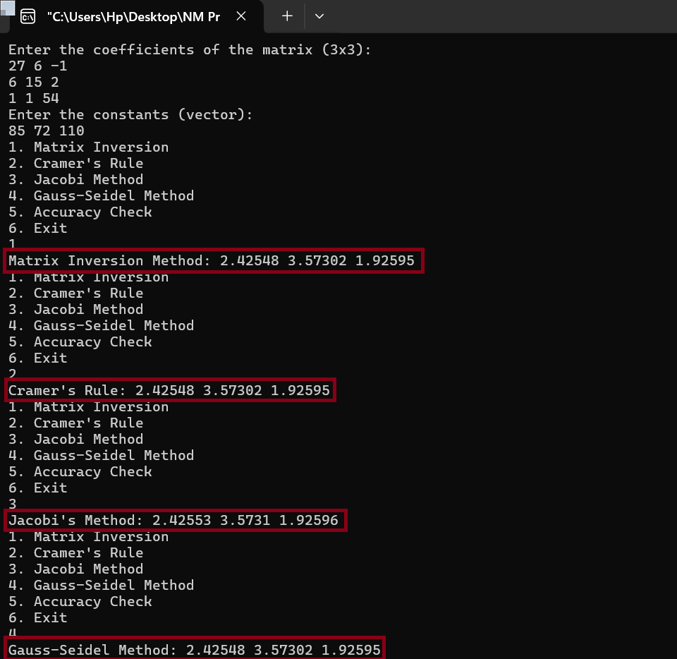
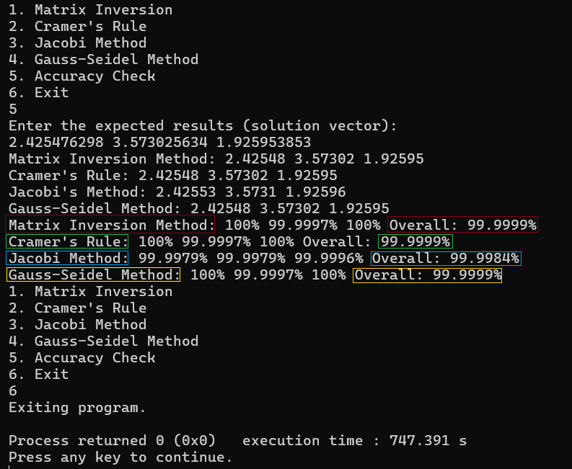
Snippet From Code
9

Slide 10


